Slide 1
Movie Recommendation System
Presented by:
Siddhi H.Thakur
Mehul A.Jain

Slide 2
Introduction
Our project is movie recommendation system. It provides user with most relevant data and suggests the user with all the movies that have highest possibility of being liked by the user.
The system uses past data patterns and past views of the user to recommend the most likable movie to user.
In this project we use Content based Recommendation system.

Slide 3
About Algorithm
A recommender system is a simple algorithm whose aim is to provide the most relevant information to a user by discovering patterns in the dataset.
The algorithm rates the items and shows the user the items that they would rate highly.
There are major two types of movie recommendation systems,one is content based and other is collaborative filtering based. Sometimes, a hybrid approach is used to develop the model.

Slide 4
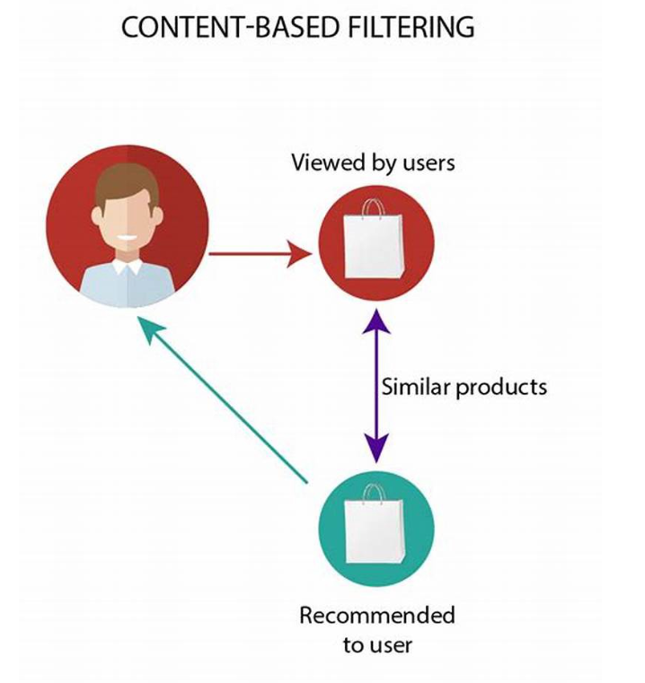
Content Based
Content-based filtering is one popular technique of recommendation or recommender systems. The content or attributes of the things you like are referred to as "content."
The system uses your features and likes in order to recommend you with things that you might like.
It uses the information provided by you over the internet and the ones they are able to gather and then they curate recommendations according to that.

Slide 5
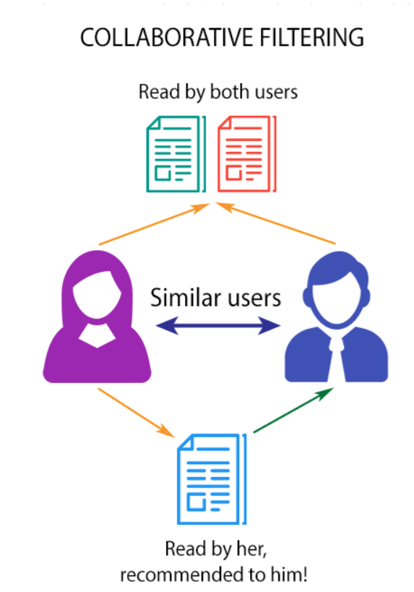
Collaborative Based
Methods for recommender systems that are primarily based on previous interactions between users and the target items are known as collaborative filtering methods.
As a result, all past data about user interactions with target objects will be fed into a collaborative filtering system. This information is usually recorded as a matrix, with the rows representing users and the columns representing items.
The basic premise of such systems is that the users' previous data should be sufficient to generate a prediction.

Slide 6
Project Progress
Collect Datasets.
Cleaning data :
Remove unwanted columns,NaN cell,duplicate value,remove outliers,
Feature Selection:
Finding constant columns, and remove them.
Feature Engineering.
Data Visualisation:
Using matplotlib,seaborn

Slide 7
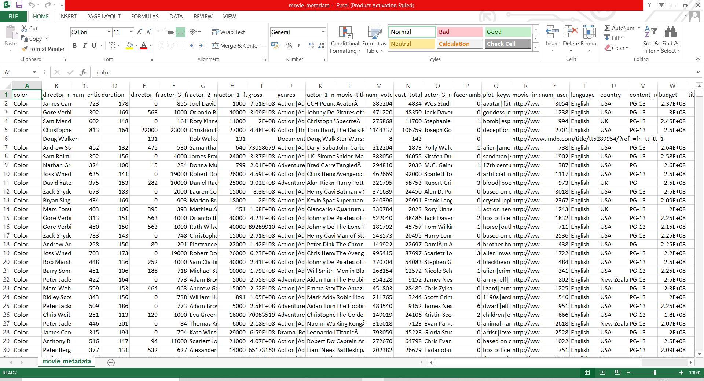

Slide 8
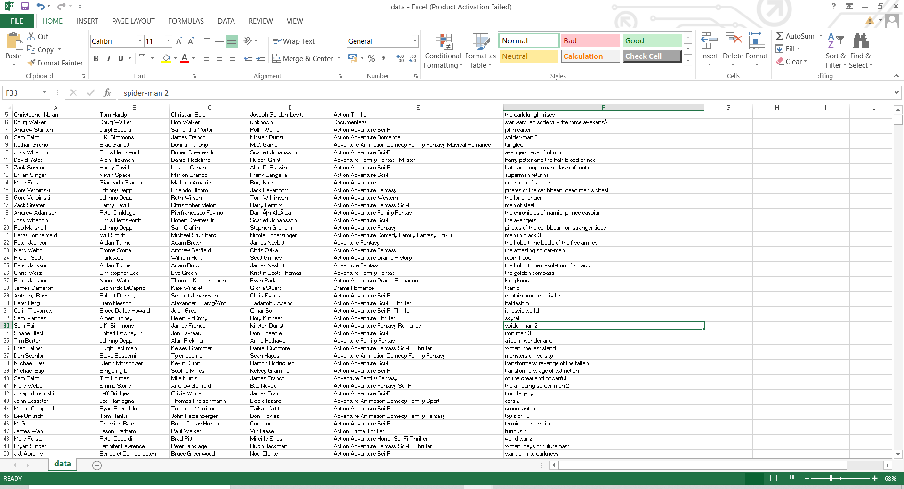
After cleaning

Slide 9
Software and Techniques
Software:
Jupyter notebook.
Google Colab
Techniques:
Recommendation System

Slide 10
Problem statement
Nowadays, people are confused about which movie to watch. Also, they are getting bored by looking at same static structure of movies on every site. To solve both of these issues, we introduced a project of movie recommendation system.
It will help users by suggesting them movies based on their past likings and dislikings of movies users has watched in past.

Slide 11
Thank you

